Slide 1

Anomaly Detection-Based on oversampling Principal Component Analysis
Batch No: A-02 Project Guide:
M. Dhenuka Datta (164G1A0521) Ms.Karamala.Hema Latha M.Tech.,
B. Divya Bharathi (164G1A0523) Assistant Professor`
G. Kaleem (164G1A0534)
P. Chakrapani (164G1A0517)
Srinivasa Ramanujan Institute of Technology
Department of Computer Science & Engineering

Slide 2
Introduction
Anomaly detection is the process of identifying unexpected items or events in data sets.
It is often applied on unlabeled data which is known as unsupervised anomaly detection.
In data mining , anomalies are referred to as outliers , noise , deviations and exceptions.
It is used in real-world applications which includes intrusion detection .

Slide 3
Existing System
In existing system, the process of detecting anomalies is done in batch mode by using traditional techniques .
Principal Component Analysis is a well known unsupervised dimension reduction method which cannot be applied to real-world large-scale applications.
Disadvantages of existing system are:
In existing system for producing the approximated PCA solutions, it requires high computation cost and high memory requirements.
Notes:
1.Density
2.Distance

Slide 4
Proposed system
We are using online over-sampling Principal Component Analysis (osPCA) in order to overcome the above problems.
Advantages of proposed system:
No need to store covariance matrix
Reduces computational cost and memory requirements

Slide 5
Abstract
Most of the anomaly detection methods are implemented in batch mode, and cannot be extended to large-scale problems .
We are using over-sampling principal component analysis (osPCA) algorithm to detect the outliers from a large amount of data via an online updating technique.

Slide 6
IMPLEMENTATION
Modules :-
Cleaning Data
Detecting Outliers

Slide 7
Module-1 (Cleaning Data)
A set of data instances in the original data set is taken as input. This data may be contaminated by noise or incorrect data .
So the cleaning is done using Over-Sampling Principal Component Analysis (osPCA) method.
And then the score of outlierness is calculated and the smallest value is taken as the threshold value.

Slide 8
Module-2 (Detecting Outlier)
In this module we detect the outlierness of the user input.
When the user gives the input to the system, the system calculate the score value for the new input.
The new score value is compared with the threshold value which is calculated in previous module.
If the score value of the new data instance is above the threshold value, then that input data is identified as an outlier. Otherwise it is considered as a normal data instance, and the PCA value of that particular data instance is updated accordingly.

Slide 9
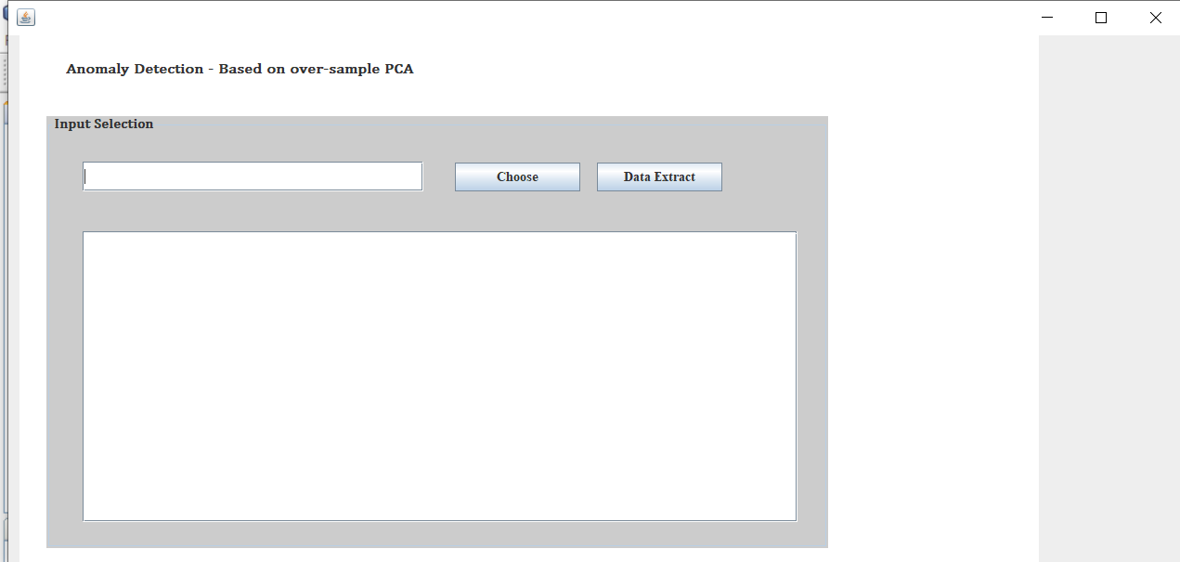
Screenshots

Slide 10
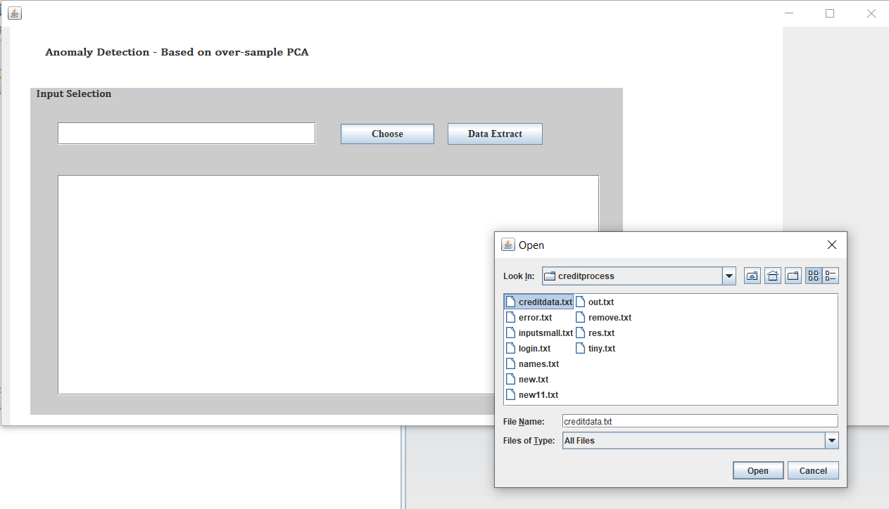

Slide 11
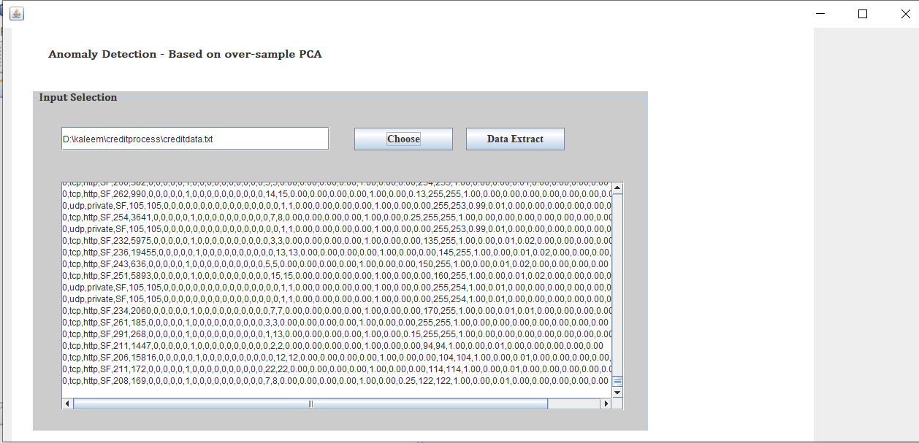

Slide 12
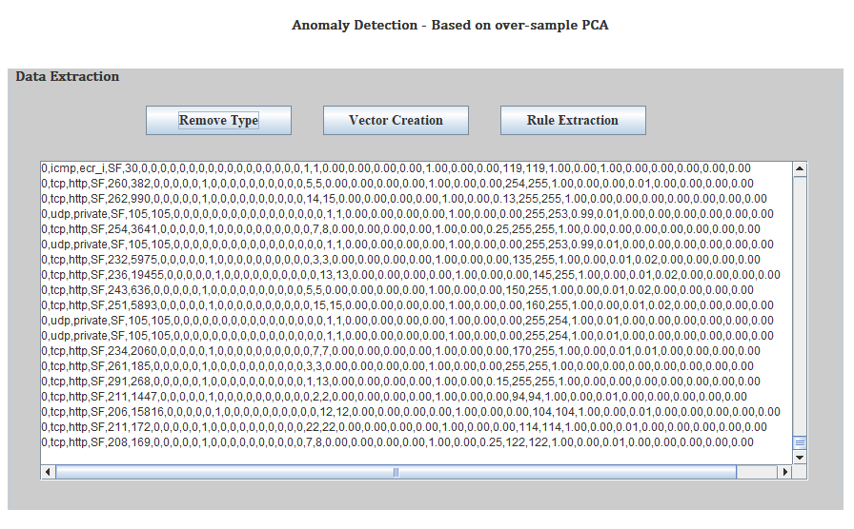

Slide 13
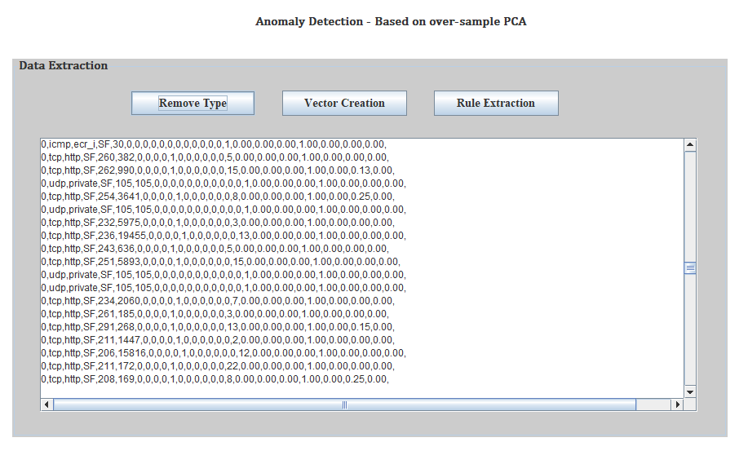

Slide 14
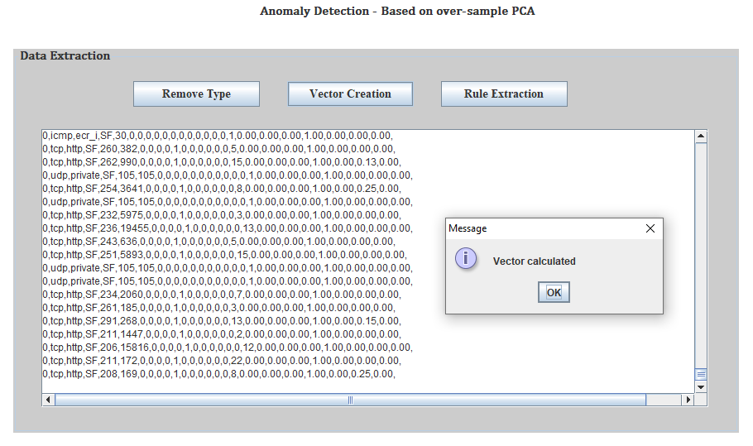

Slide 15
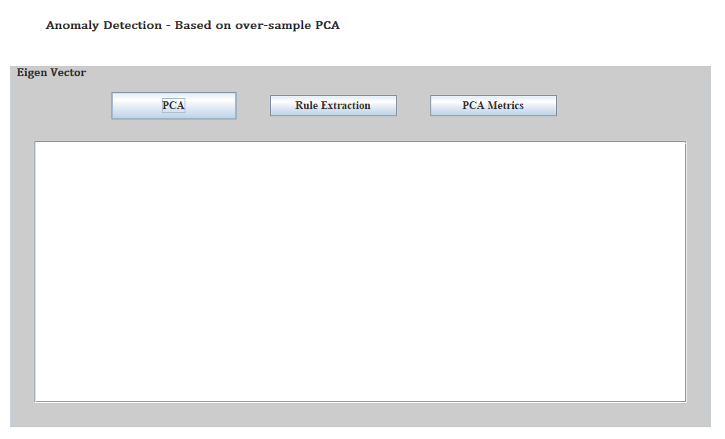

Slide 16
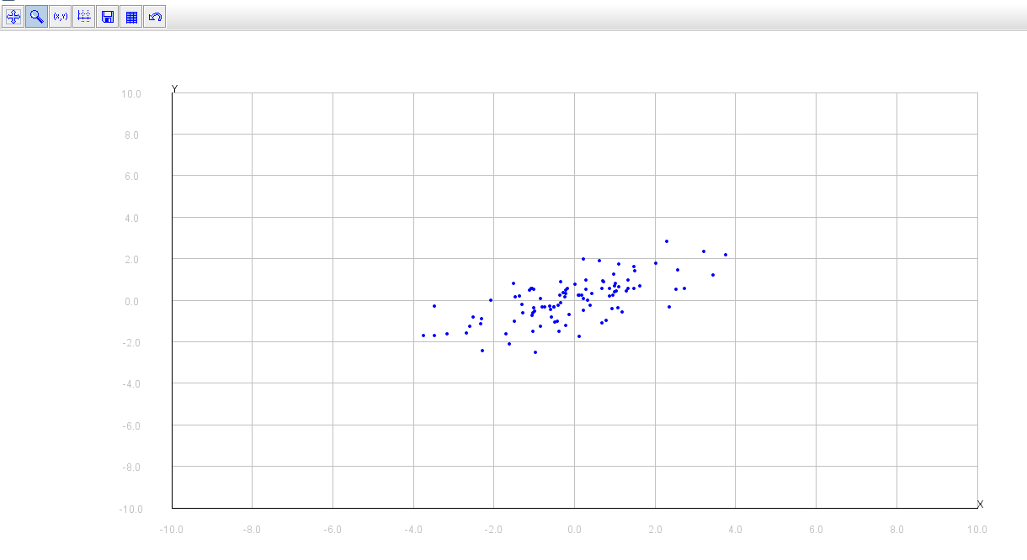

Slide 17
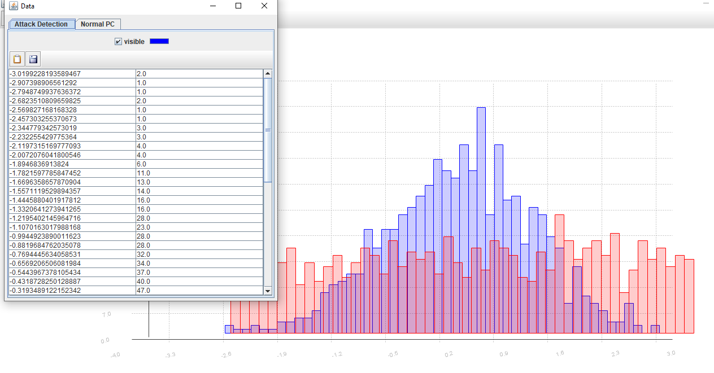

Slide 18
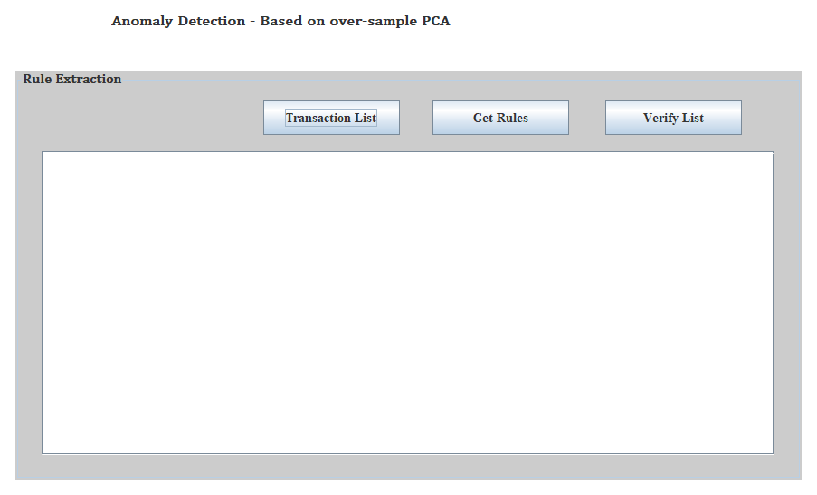

Slide 19
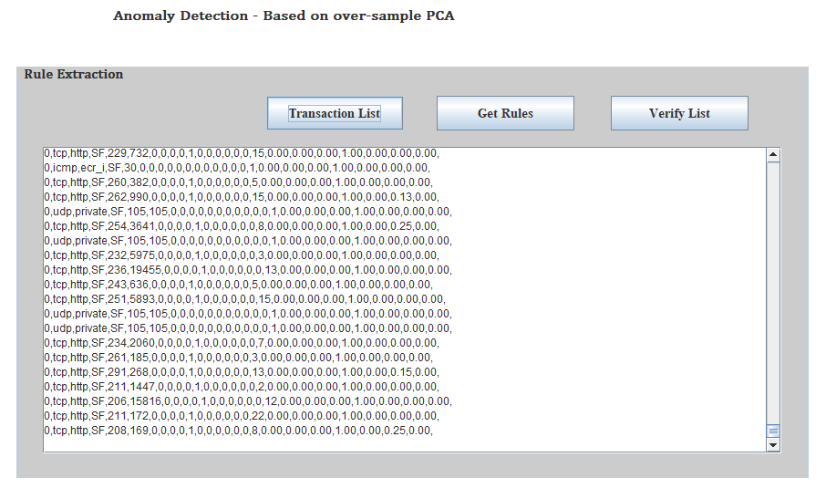

Slide 20
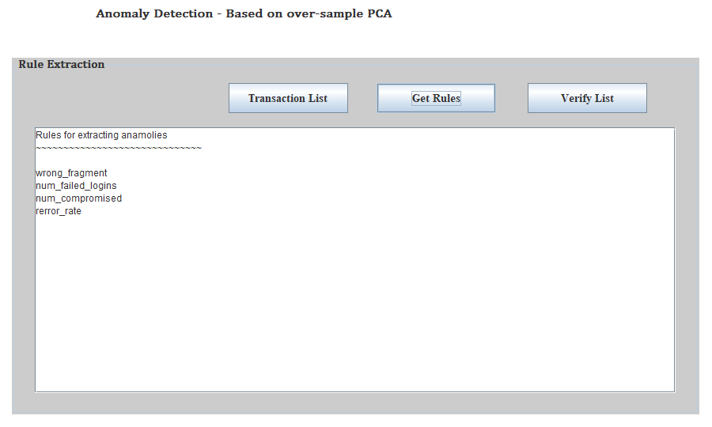

Slide 21
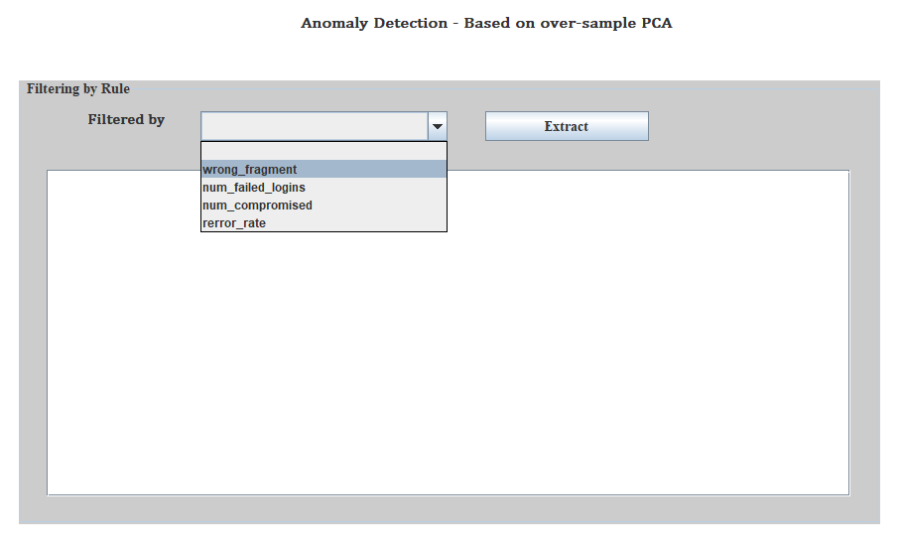

Slide 22
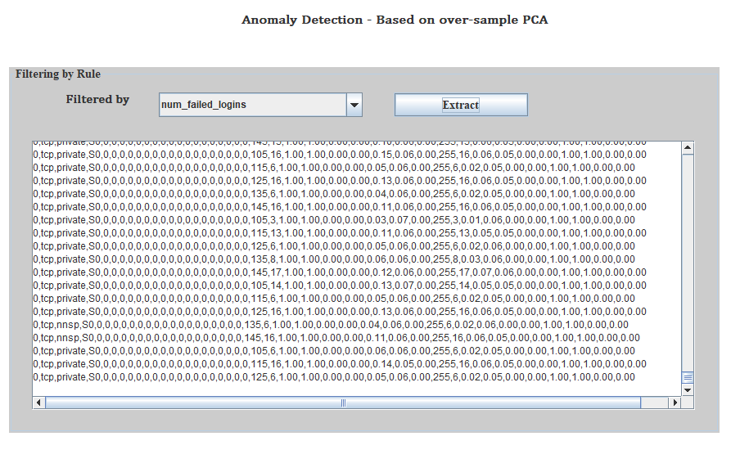

Slide 23
Conclusion
In our project, we are using an online anomaly detection method based on over-sample PCA.
We show that the osPCA will amplify the effect of outliers.
No need to store covariance matrix.
Reduces computational cost and memory requirements.
Notes:
Leave One Out (LOO)

Slide 24
Thank you
Queries
?

